Slide 1

SMS Spam Detection Using Machine Learning
Department of Computer Applications
AI-Powered Spam Filtering with API Integration
Project Guide:
Mr. MOHAMMED ALISHA M.Tech.,(Ph.D.)
Durga Maheswari Konda
23P31F0042

Slide 2
Topics
Abstract
Existing System and Disadvantages
Proposed System and Advantages
System Architecture
Modules
Functional Requirements
Non-Functional Requirements
Software Requirements
Hardware Requirements
Screenshots
Conclusion & Future Scope

Slide 3
ABSTRACT
This project focuses on detecting spam messages using a Machine Learning model, which is seamlessly integrated with a Telegram bot for easy interaction. At the core of this system lies the Naive Bayes algorithm, CNN, Support Vector Machine powerful classification technique trained on a dataset containing SMS messages that are already labeled as either spam or ham (not spam).
When a user sends a message to the Telegram bot, the model instantly analyzes the content and accurately predicts whether the message is spam or not. The system is built to be lightweight and efficient, allowing it to work in real-time.
In addition, the architecture is designed to be flexible and extendable, meaning it can be easily adapted to other messaging platforms such as WhatsApp, Slack, or even integrated into email services in the future. This makes the solution not only practical but also scalable for wider use cases.

Slide 4
Existing System
Right now, spam messages are usually blocked by built-in filters in email apps but not in messaging platforms.
These filters work by checking for certain words or rules that are known to be used in spam. For
example, they may block messages with words like "Congratulations, you won!" or links that look suspicious.
Most of these systems:
Are used in emails, not messaging apps like Telegram.
Work in the background without user control.
Don’t use smart methods like machine learning in real-time for all platforms.

Slide 5
Disadvantages of the Existing System
Not Smart Enough: They follow fixed rules, so they can’t understand or learn new types of spam
messages on their own.
Not Fast or Interactive: They don't reply to the user or give instant results like a Telegram bot does.
Not Made for All Apps: These systems are mostly made for email, not for messaging apps like Telegram,
WhatsApp, or Slack.
Can Be Wrong: Sometimes, they block useful messages or let spam through because they don’t
understand the meaning of the message properly.

Slide 6
Proposed System
In my project, I built a smart spam message detection system using Machine Learning and connected it with a Telegram bot.
Uses CNN (to detect important word patterns) and GRU Gated Recurrent Unit (to understand sentence flow).
This combination makes spam detection more accurate and faster than older methods.
Here’s how it works:
We trained a Naive Bayes model using a dataset of real messages that are labeled as either spam or not spam.
When a user sends a message to the Telegram bot, it checks the message and instantly replies if it is spam or not.
This system can also be improved and connected to other platforms like WhatsApp, Slack, or websites in the future.

Slide 7
Advantages of Proposed System
Real-Time Response: Instantly tells the user if a message is spam or not through the Telegram bot.
User-Friendly: Very easy to use – just send a message to the bot and get the result in seconds.
Extendable: The same system can be expanded to work with other apps or websites, not just Telegram.
No Manual Updates: Since it learns from the data, there is no need to update the rules manually like old systems.
Lightweight and Fast: Doesn’t take much space or time – it works quickly and efficiently.
Smart Detection: Uses machine learning to understand and detect spam better than traditional rule-based systems.

Slide 8
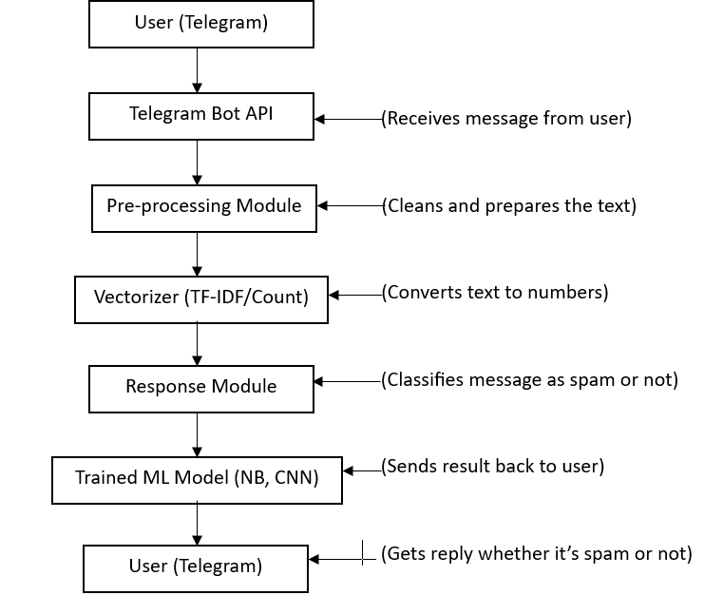
System Architecture

Slide 9
Modules
1. Text Cleaning Module (Preprocessing)
This part cleans the message before checking it. It removes unwanted symbols, stopwords (like "the", "is", etc.), and makes the message lowercase.
Example: "Congratulations! You've won!" → "congratulations won“
2. Text to Numbers Module (Vectorizer)
After cleaning, the message is converted into numbers. This is because machine learning models can’t understand text — they need numbers.
Tool Used: CountVectorizer
3. Spam Detection Module (ML Model)
This part is the "brain" of the system. It uses a trained Naive Bayes model to check if the message is spam or not.
Example: Input: "You won a free ticket!" → Output: Spam

Slide 10
Modules
4. Telegram Bot Module
This is how the user talks to the system. The bot receives messages from users and shows the result instantly.
Example: User → Sends message → Bot replies: "This is spam.“
5. Reply Module
This part prepares the final message that is sent back to the user, like:
✅ "This message is not spam."
❌ "This message is detected as spam.“
6. API Module (Future Scope)
This is used to connect the same system to WhatsApp, Slack, or any website using an API.

Slide 11
Functional Requirements
1. Message Input via Telegram
The system should allow users to send any text message using a Telegram bot.
2. Text Preprocessing
The system should clean the message by removing:
Punctuation
Stopwords (like "the", "is", "a", etc.)
Converting to lowercase
3. Convert Text to Numbers
The system should convert the cleaned message into numerical data using CountVectorizer.
4. Spam Detection
The system should use the trained Naive Bayes model to check if the message is:
Spam ❌
Not Spam ✅
. 5. Send Response Back to User
The system should reply to the user instantly through the Telegram bot with a result like:
"This message is spam."
"This message is not spam."

Slide 12
Non-Functional Requirements
1. Performance
The system should respond within 1–2 seconds.
2. Accuracy
The model should maintain around 98% accuracy.
3. Scalability
The system should be able to handle messages from multiple users at the same time without crashing.
4. Usability
The Telegram bot should be easy to use for all users, even for someone who has no technical background. They should simply send a message and get a clear reply.
5. Maintainability
The project code should be well-organized and easy to update, so that new features (like WhatsApp or Slack integration) can be added in the future.
6. Security
The system should ensure that user messages are not stored or misused, keeping their communication private and safe.

Slide 13
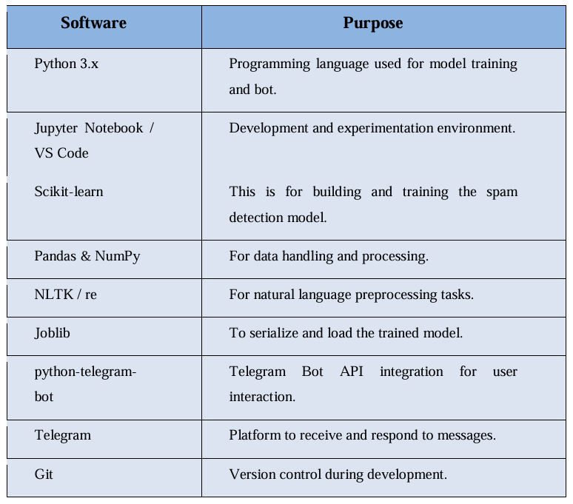
Software Requirements

Slide 14
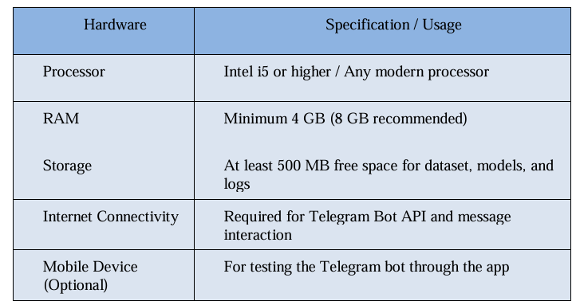
Hardware Requirements

Slide 15
UML Diagrams

Slide 16
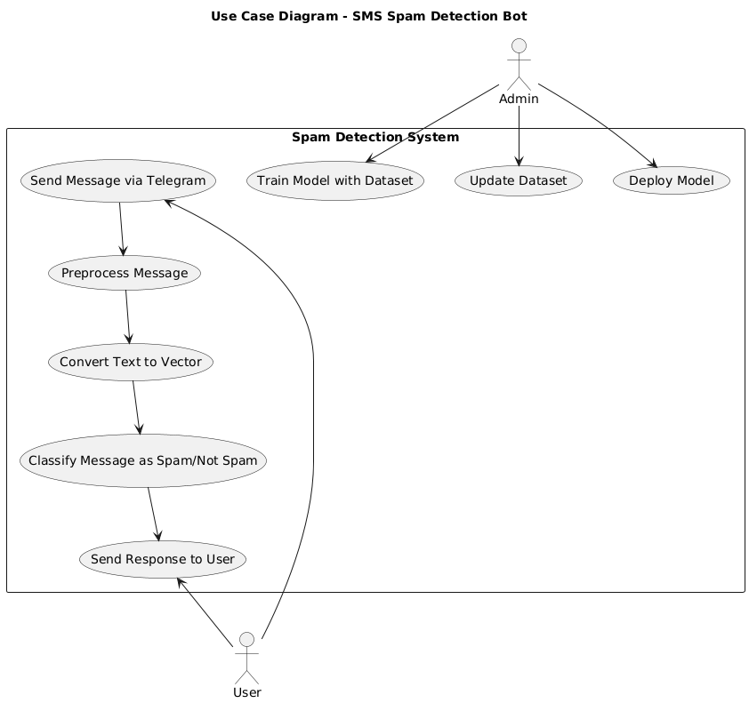

Slide 17
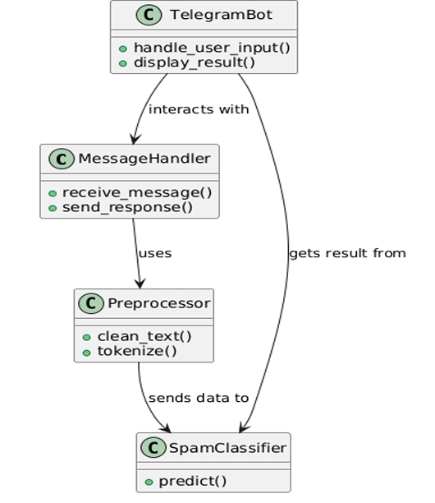
Class Diagram

Slide 18
SCREENSHOTS

Slide 19
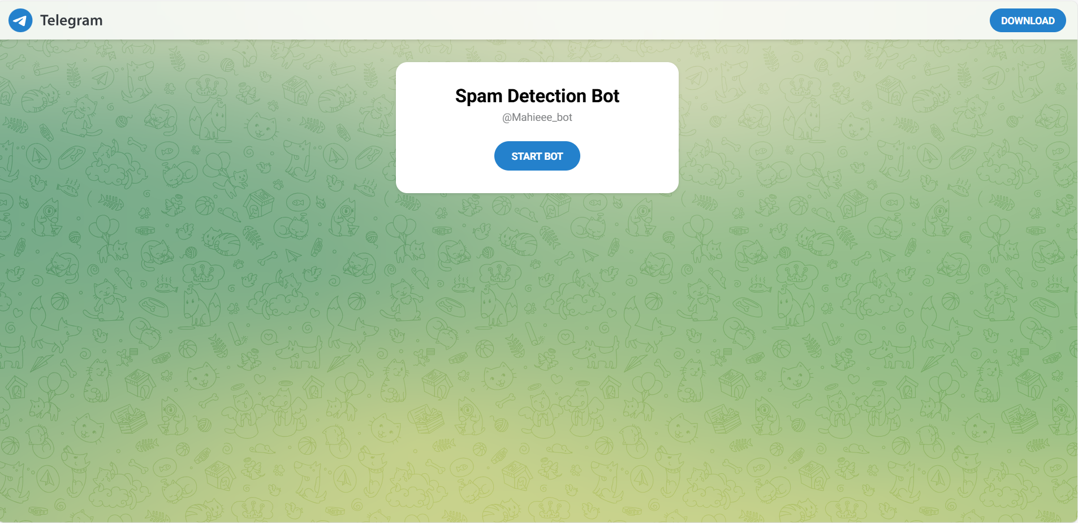
Fig. 1: Telegram Interface of Spam Detection Bot

Slide 20
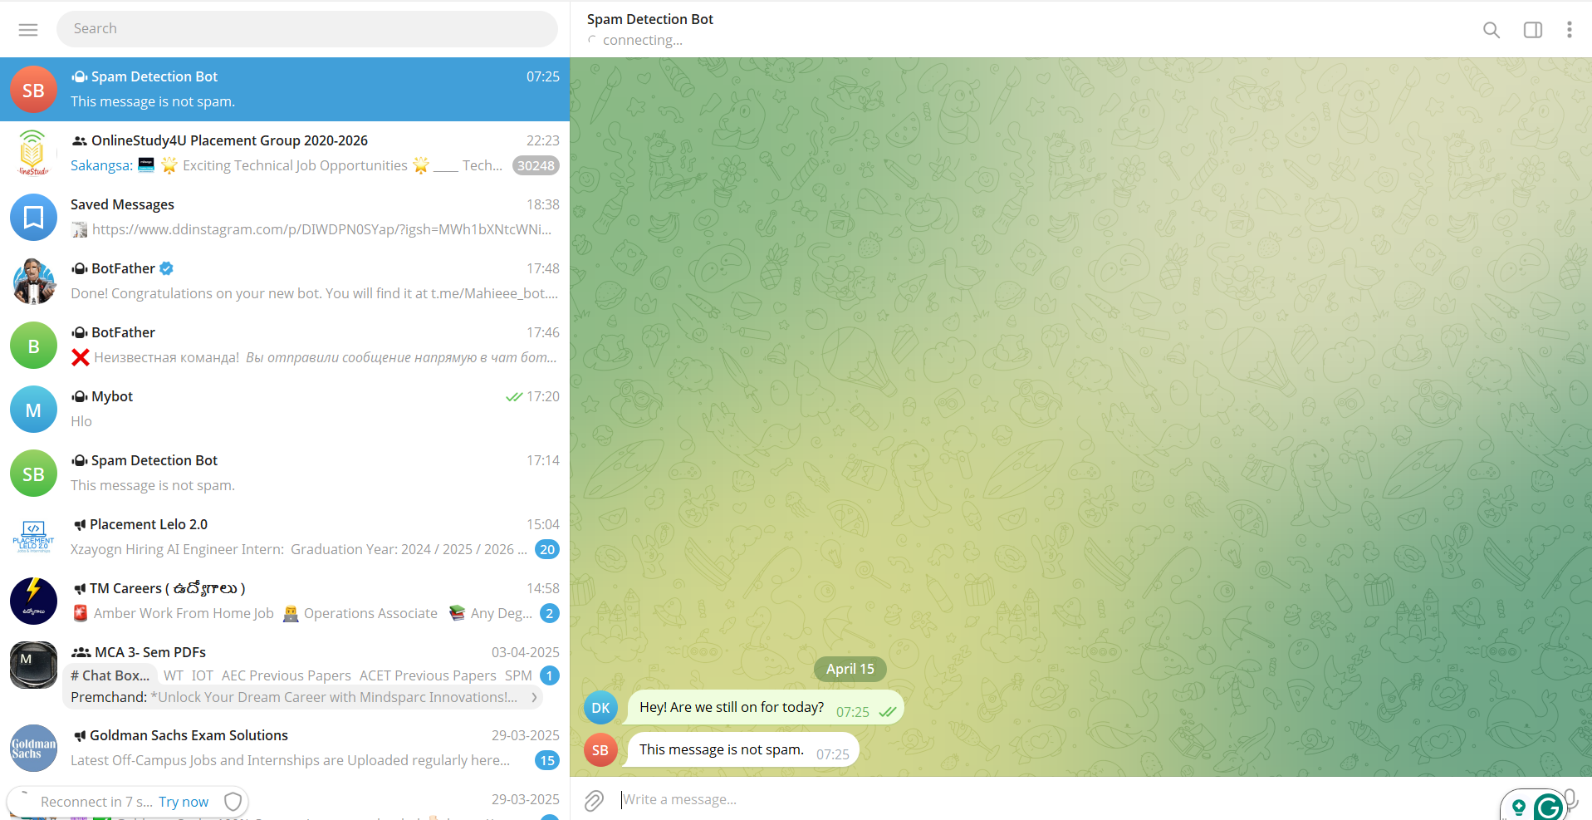
Fig. 2: Screenshot showing the Spam Detection Bot identifying the message as not spam.

Slide 21
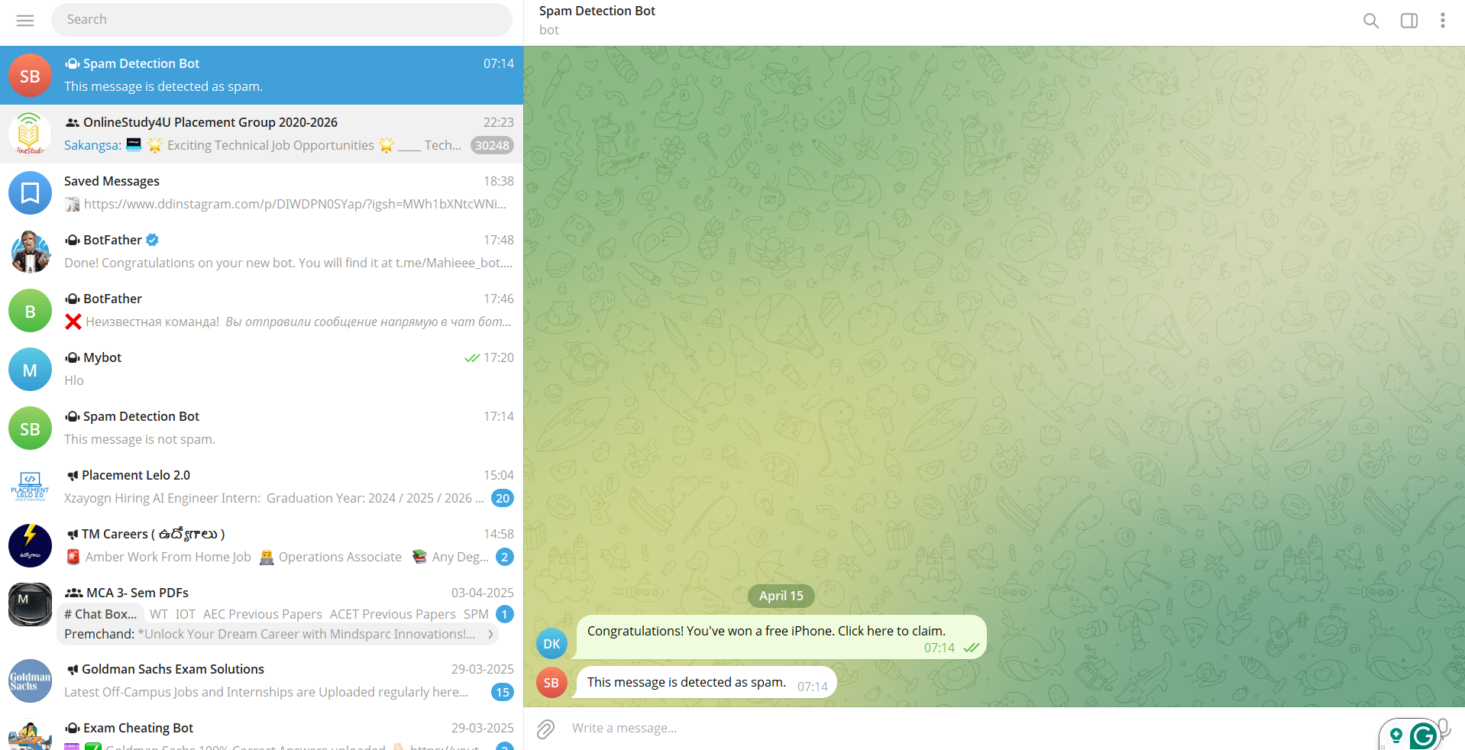
Fig. 3: Screenshot showing the Spam Detection Bot identifying the message as spam.

Slide 22
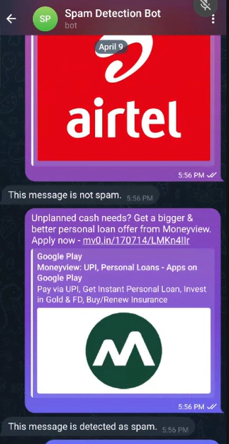
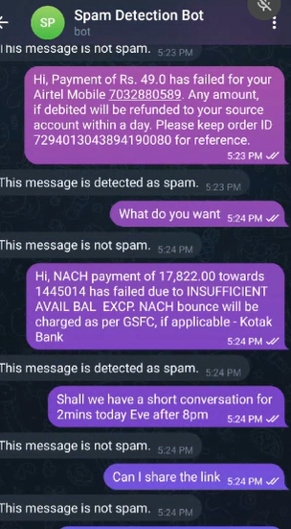
Fig. 4: Screenshot showing the Spam Detection Bot identifying the messages as spam and not spam.

Slide 23
Conclusion & Future Scope
The SMS Spam Detection System with API support offers a modern and efficient solution to tackle spam messages. By combining machine learning with Natural Language Processing (NLP), it can accurately identify spam messages in real time. The system currently works with Telegram but has the potential to be extended to other messaging platforms like SMS, WhatsApp, and Slack.
Detect Spam in Multiple Languages: Enable language detection and build models for regional languages.
Custom Spam Rules: Allow users to define personal spam rules and block specific contacts or phrases.
Spam Reports Dashboard: Create a dashboard to display spam stats, message logs, and user feedback.
Learning from Feedback: Enhance accuracy by learning from user-reported false positives and negatives.

Slide 24
THANK YOU

